Slide 1
AAD UNIT 2

Slide 2
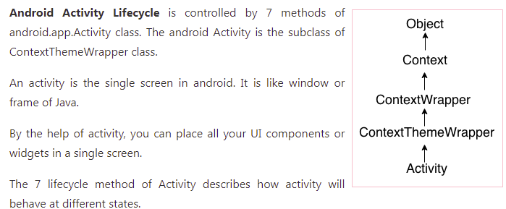
Android Activity Lifecycle

Slide 3
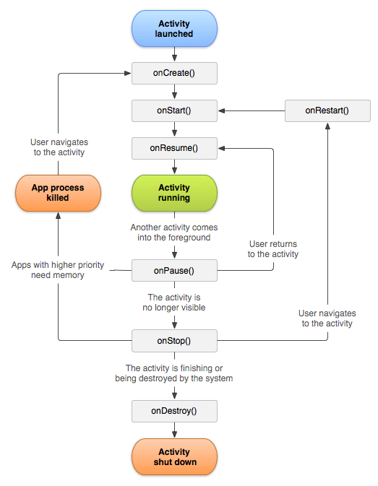
Activity Life Cycle

Slide 4
Lifecycle Methods of an Activity
onCreate()-called when activity is launched.
onStart()-called when user interface is visible to user.
onResume()-called when user interaction started or when activity got resumed.
onStop()-called when user interface is no longer visible.
onDestroy()-called before user terminates application manually or when system tries to kill activity so that other application needs memory.
onRestart()-called when user tries to restart activity after long time.

Slide 5
Active state
When an Activity is in active state, it means it is active and running.
It is visible to the user and the user is able to interact with it.
Android Runtime treats the Activity in this state with the highest priority and never tries to kill it.

Slide 6
Paused state
An activity being in this state means that the user can still see the Activity in the background such as behind a transparent window or a dialog box i.e it is partially visible.
The user cannot interact with the Activity until he/she is done with the current view.
Android Runtime usually does not kill an Activity in this state but may do so in an extreme case of resource crunch.

Slide 7
Stopped state
When a new Activity is started on top of the current one or when a user hits the Home key, the activity is brought to Stopped state.
The activity in this state is invisible, but it is not destroyed.
Android Runtime may kill such an Activity in case of resource crunch.

Slide 8
Destroyed state
When a user hits a Back key or Android Runtime decides to reclaim the memory allocated
to an Activity i.e in the paused or stopped state, It goes into the Destroyed state.
The Activity is out of the memory and it is invisible to the user.
Note: An Activity does not have the control over managing its own state. It just goes through
state transitions either due to user interaction or due to system-generated events.

Slide 9
Life cycle Example program
import android.support.v7.app.AppCompatActivity;
import android.os.Bundle;
import android.widget.Toast;
public class MainActivity extends AppCompatActivity {
@Override
protected void onCreate(Bundle savedInstanceState) {
super.onCreate(savedInstanceState);
setContentView(R.layout.activity_main);
Toast.makeText(getApplicationContext(), "onCreate Called", Toast.LENGTH_LONG).show();
}
protected void onStart() {
super.onStart();
Toast.makeText(getApplicationContext(), "onStart Called", Toast.LENGTH_LONG).show();
}
@Override
protected void onRestart() {
super.onRestart();
Toast.makeText(getApplicationContext(), "onRestart Called", Toast.LENGTH_LONG).show();
}

Slide 10
protected void onPause() {
super.onPause();
Toast.makeText(getApplicationContext(), "onPause Called", Toast.LENGTH_LONG).show();
}
protected void onResume() {
super.onResume();
Toast.makeText(getApplicationContext(), "onResume Called", Toast.LENGTH_LONG).show();
}
protected void onStop() {
super.onStop();
Toast.makeText(getApplicationContext(), "onStop Called", Toast.LENGTH_LONG).show();
}
protected void onDestroy() {
super.onDestroy();
Toast.makeText(getApplicationContext(), "onDestroy Called", Toast.LENGTH_LONG).show();
}
}

Slide 11
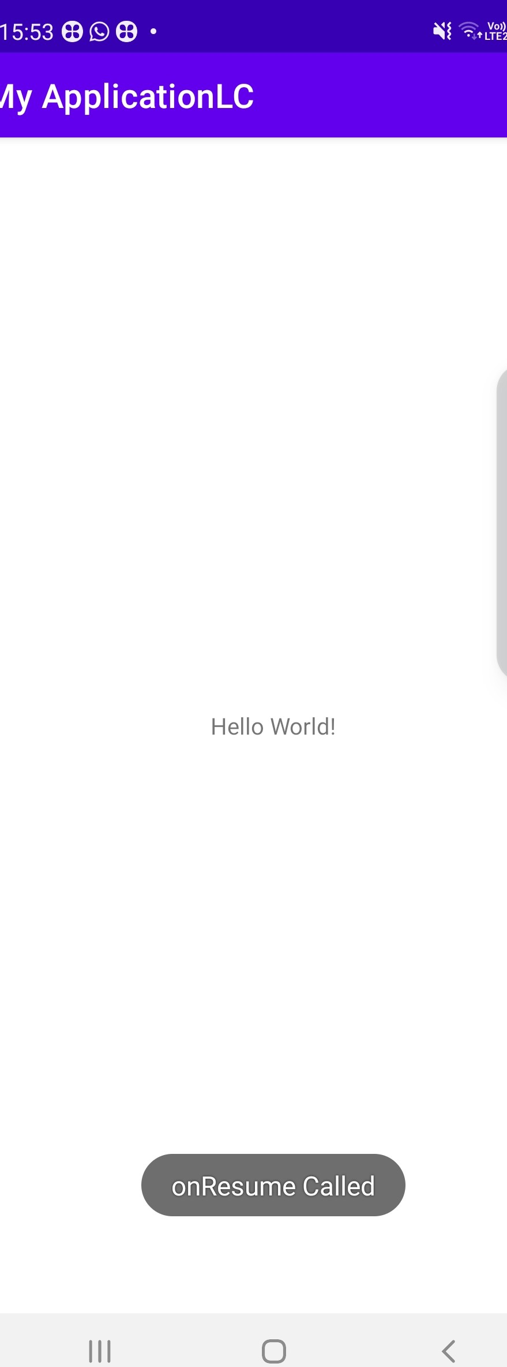

Slide 12
Device Display measuring units

Slide 13
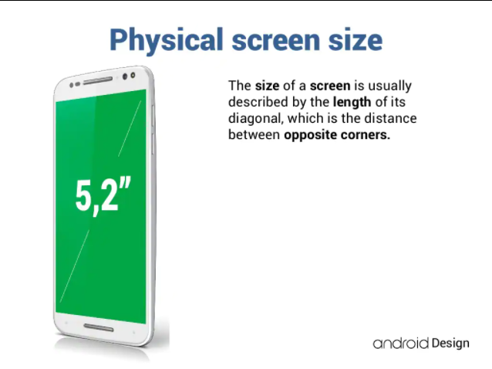
Properties of Device Display

Slide 14
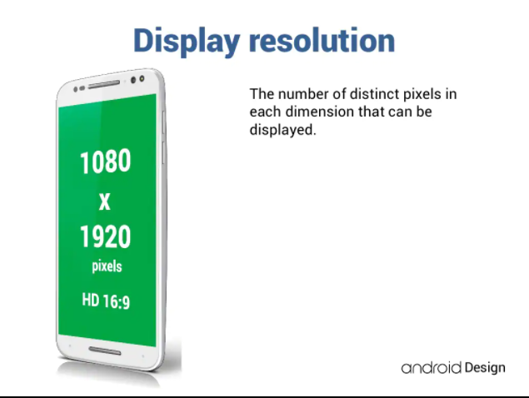

Slide 15
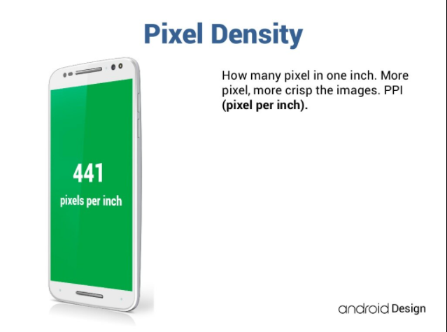

Slide 16
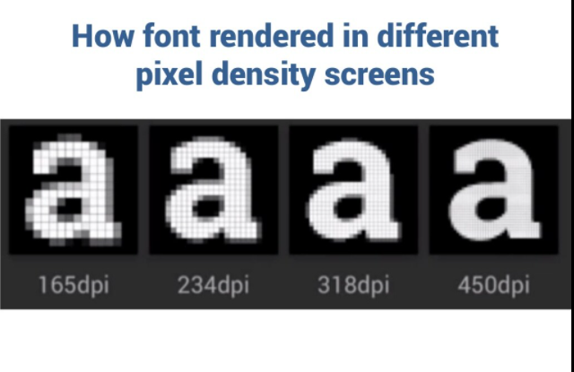

Slide 17
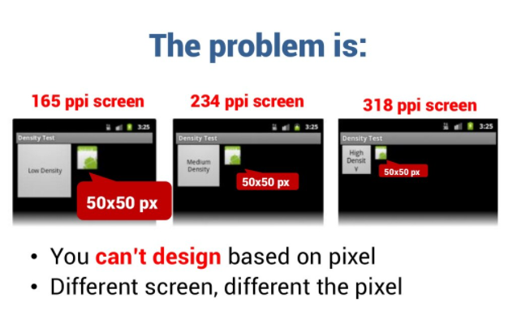

Slide 18
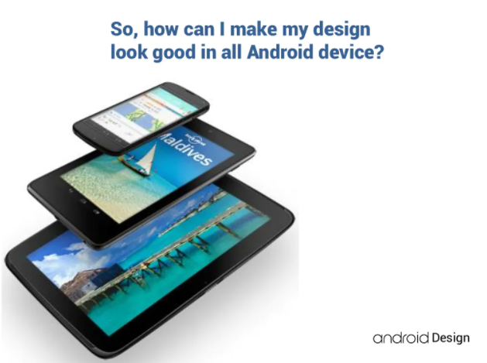

Slide 19
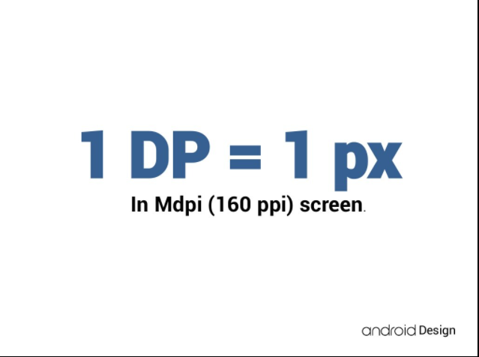

Slide 20
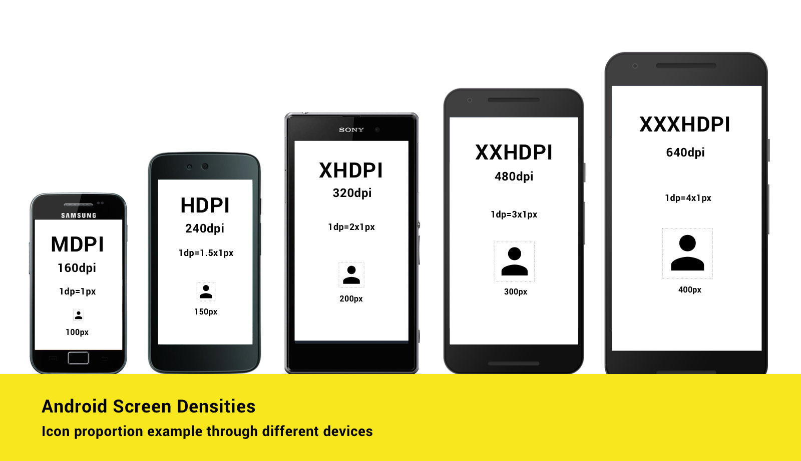

Slide 21
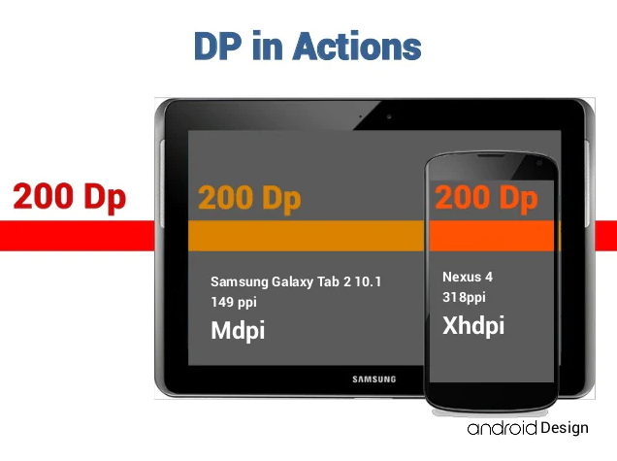

Slide 22
Android Display device measuring units
Density-independent pixels
Density-independent pixels, written as dp (pronounced "dips")
, are flexible units that scale to have uniform dimensions
on any screen. They provide a flexible way to accommodate a
design across platforms.
Scalable pixels
Scalable pixels (sp) serve the same function as density-independent pixels (dp),
but for fonts.

Slide 23
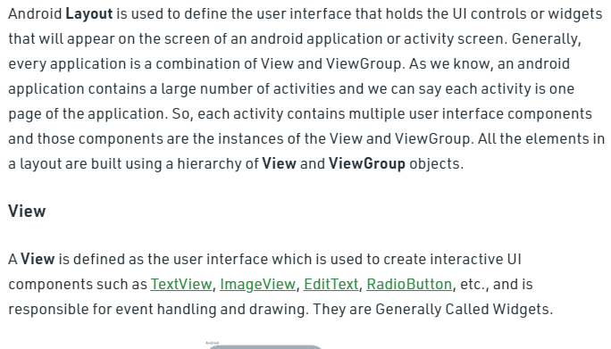

Slide 24
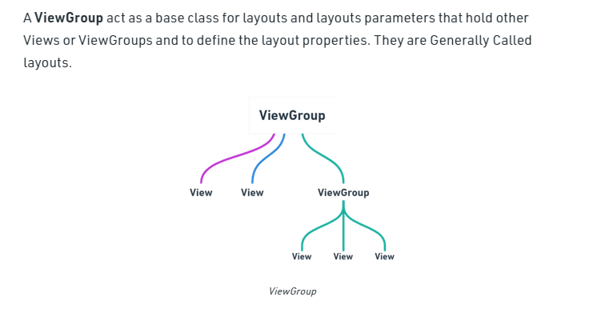

Slide 25
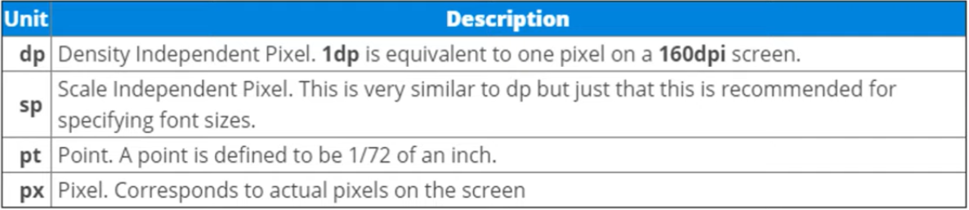

Slide 26
Android UI Layouts
In android, Layout is used to define the user interface for an app or activity and it will hold the UI elements that will appear to the user.
The user interface in the android app is made with a collection of View and ViewGroup objects.
Generally, the android apps will contain one or more activities and each activity is one screen of the app.
The activities will contain multiple UI components and those UI components are the instances of View and ViewGroup subclasses.
The View is a base class for all UI components in android and it is used to create an interactive UI components such as TextView, EditText, Checkbox, Radio Button, etc. and it responsible for event handling and drawing.

Slide 27
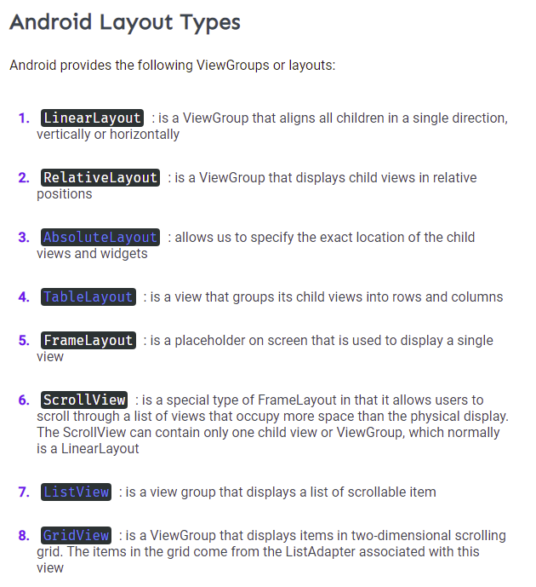

Slide 28
The ViewGroup is a subclass of View and it will act as a base class for layouts and layouts parameters. The ViewGroup will provide an invisible containers to hold other Views or ViewGroups and to define the layout properties.
In android, we can define a layouts in two ways, those are
Declare UI elements in XML
Instantiate layout elements at runtime
The android framework will allow us to use either or both of these methods to define our application’s UI.

Slide 29
Declare UI Elements in XML
In android, we can create layouts same like web pages in HTML by using default Views and ViewGroups in the XML file.
The layout file must contain only one root element, which must be a View or ViewGroup object.
Once we define the root element, then we can add additional layout objects or widgets as child elements to build the View hierarchy that defines our layout.

Slide 30
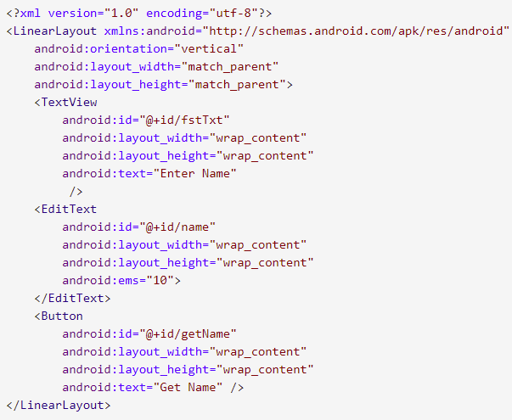
Following is the example of defining a layout in an XML file (activity_main.xml) using LinearLayout to hold a TextView, EditText, and Button.

Slide 31
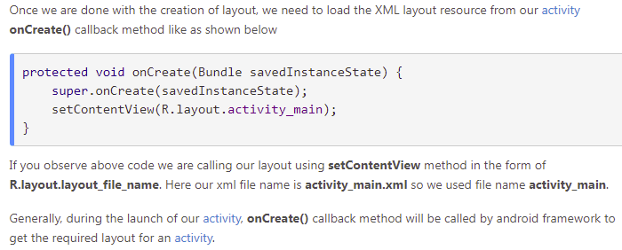
Load XML Layout File from an Activity

Slide 32
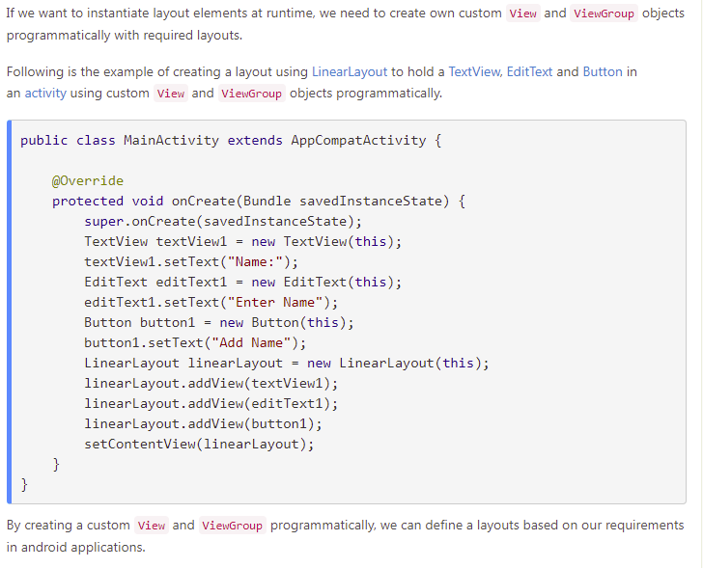
Instantiate Layout Elements at Runtime

Slide 33
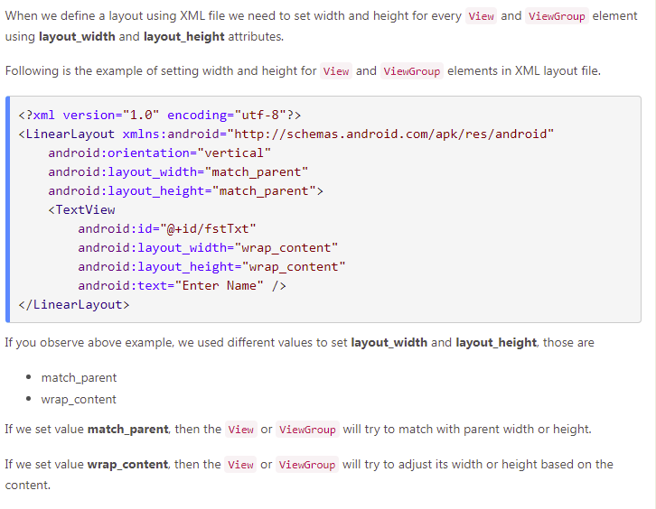
Width and Height

Slide 34
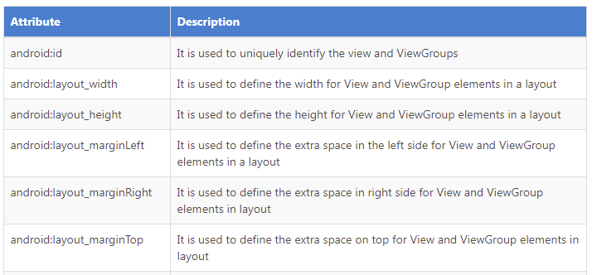
Android Layout Attributes

Slide 35
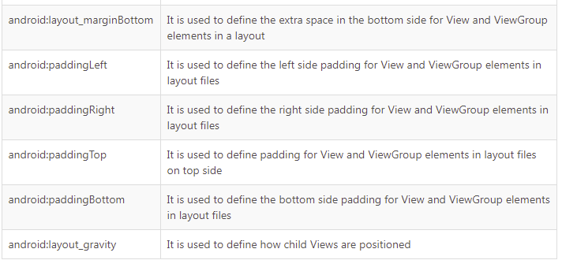

Slide 36
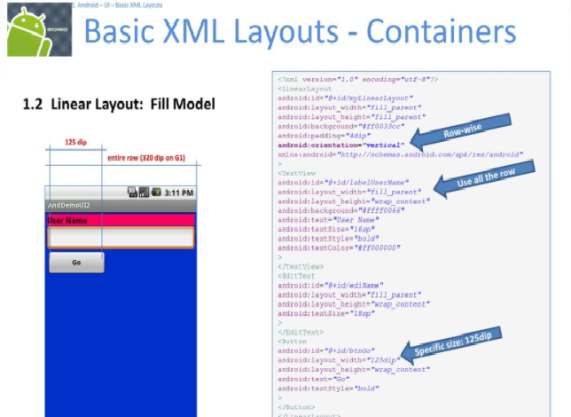

Slide 37
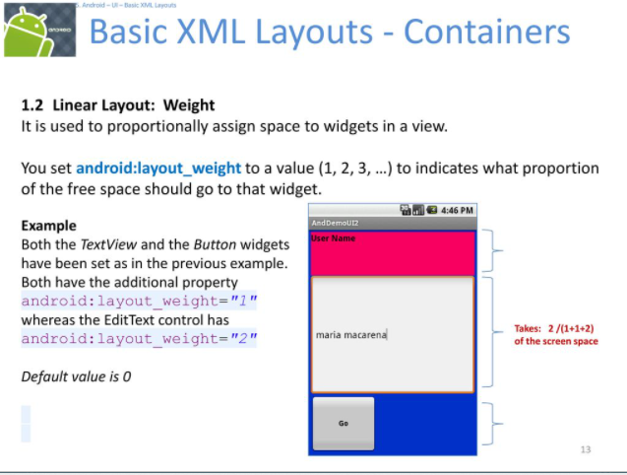

Slide 38
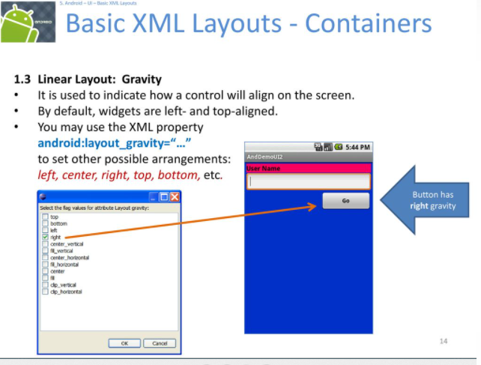

Slide 39
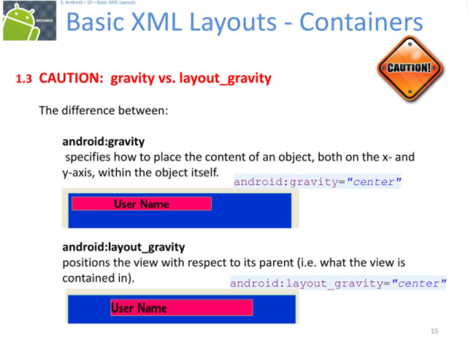

Slide 40
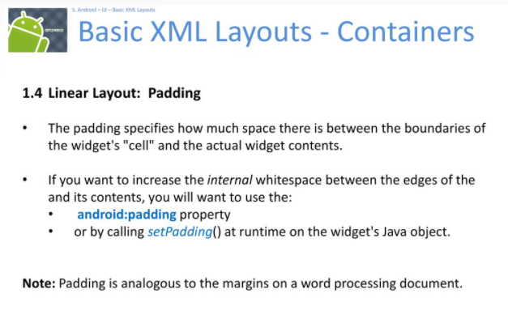

Slide 41
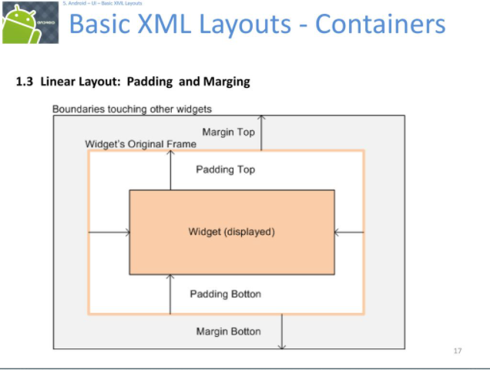

Slide 42
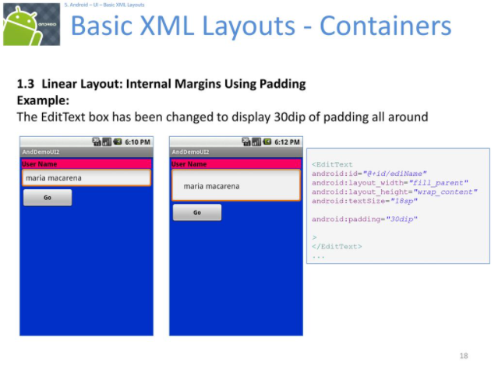

Slide 43
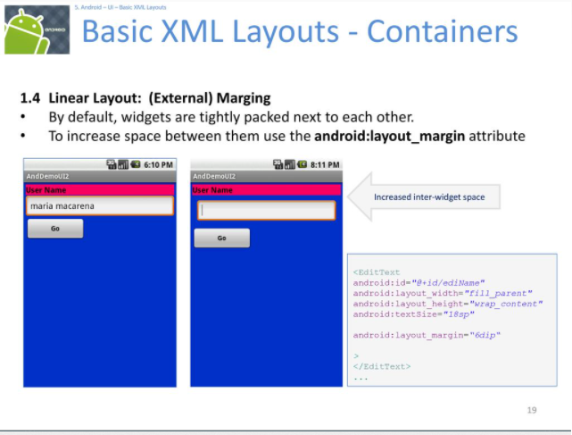

Slide 44
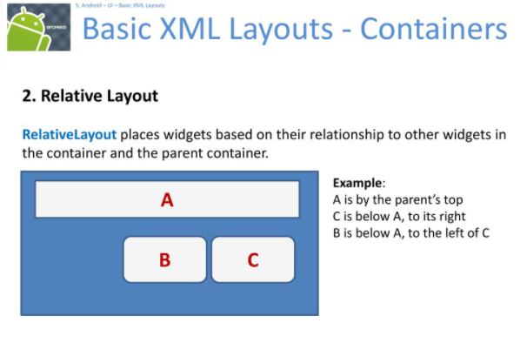

Slide 45
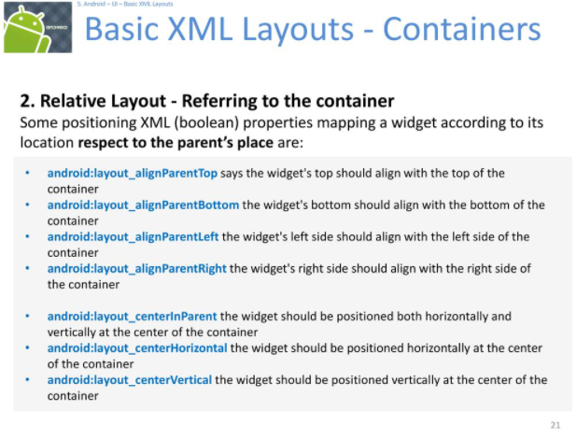

Slide 46
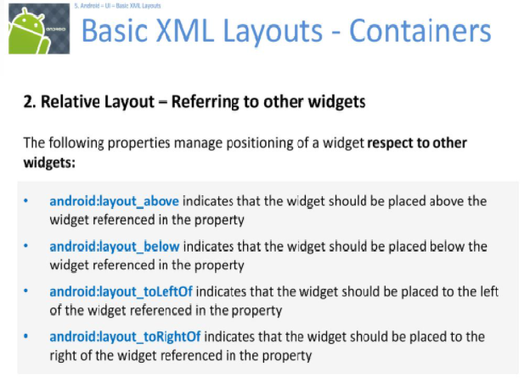

Slide 47
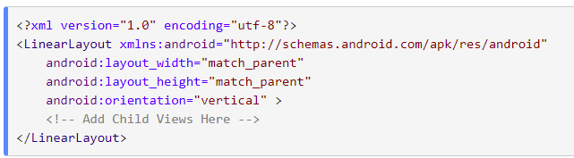
Android LinearLayout
In android, LinearLayout is a ViewGroup subclass which is used to render all child View instances one by one either in Horizontal direction or Vertical direction based on the orientation property.
In LinearLayout, the child View instances arranged one by one, so the horizontal list will have only one row of multiple columns and vertical list will have one column of multiple rows.

Slide 48
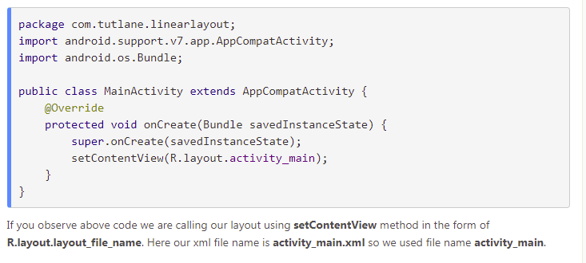
MainActivity.java

Slide 49
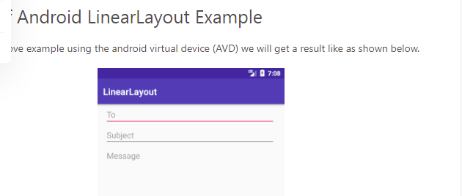

Slide 50
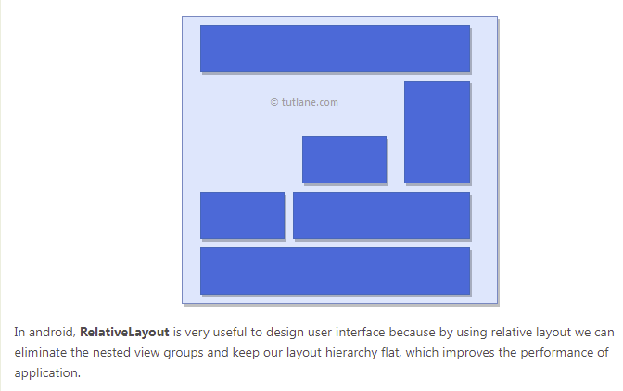
Android RelativeLayout
In android, RelativeLayout is a ViewGroup which is used to specify the position of child View instances relative to each other (Child A to the left of Child B) or relative to the parent (Aligned to the top of parent). Following is the pictorial representation of relative layout in android applications.

Slide 51
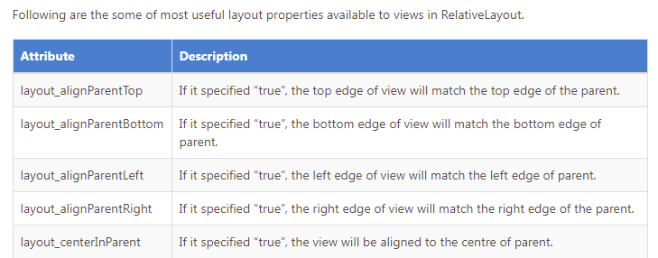
Android Positioning Views in Relative Layout

Slide 52
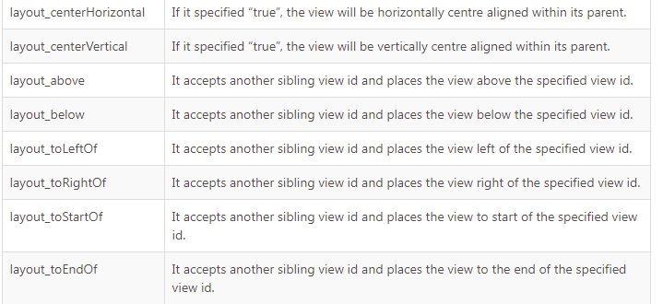

Slide 53
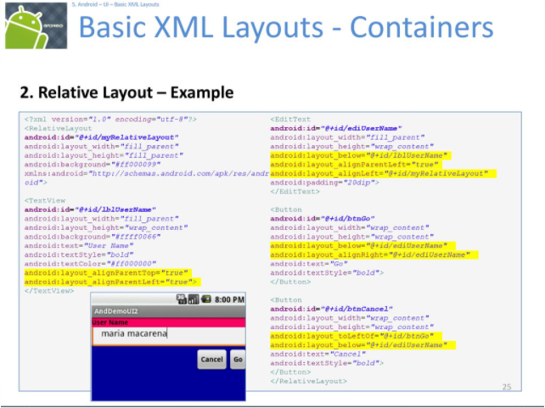

Slide 54
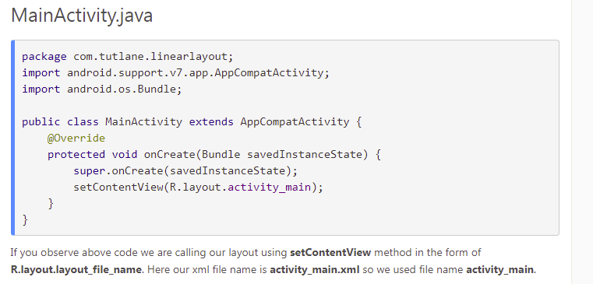

Slide 55
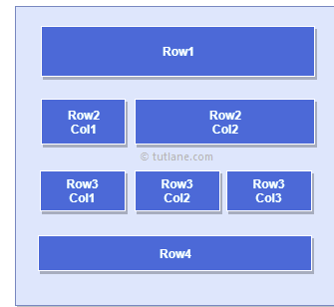
Android TableLayout
In android, TableLayout is a ViewGroup subclass that is used to display the child View elements in rows and columns. Following is the pictorial representation of table layout in android applications.
In android, TableLayout will position its children elements into rows and columns and it won’t display any border lines for rows, columns or cells.
The TableLayout in android will work same as the HTML table and the table will have as many columns as the row with the most cells. The TableLayout can be explained as <table> and TableRow is like <tr> element.

Slide 56
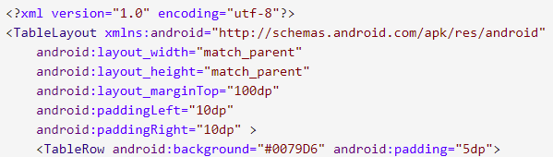
Android TableLayout Example
Create a new android application using android studio and give names as TableLayout. In case if you are not aware of creating an app in android studio check this article Android Hello World App. Now open an activity_main.xml file from \res\layout path and write the code like as shown below
activity_main.xml

Slide 57
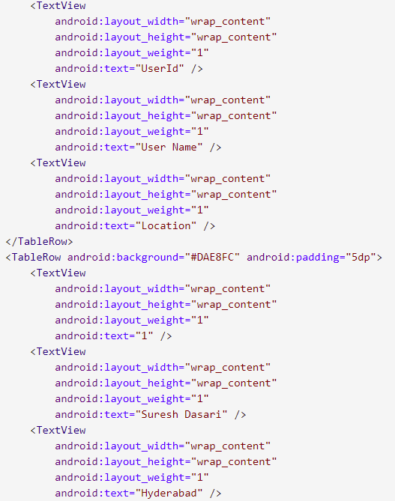

Slide 58
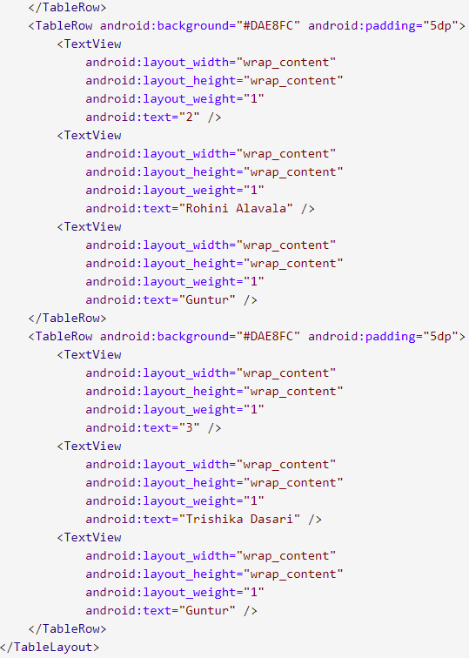

Slide 59
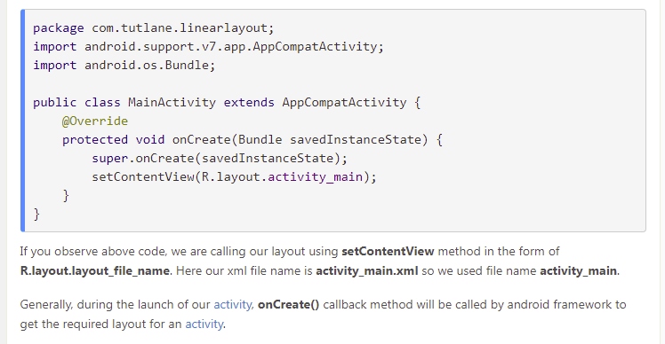
Once we are done with creation of layout, we need to load the XML layout resource from our activity onCreate() callback method, for that open main activity file MainActivity.java from \java\com.tutlane.tablelayout path and write the code like as shown below. MainActivity.java

Slide 60
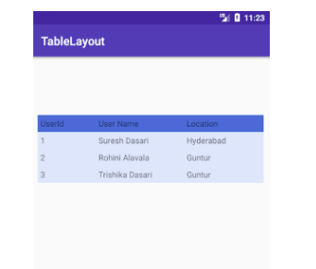
Output of Android TableLayout

Slide 61
GridLayout

Slide 62
The following android:layout_column=”2″ and android:layout_row=”1″ propert indicates that view will be placed in the cell and row 1, column 2 of the parent GridLayout.
In the case of android GridLayout property android:layout_columnSpan=”3″ and android:layout_rowSpan=”2″ view is configured to span 3 columns and 2 rows and to fill the space available both horizontally and vertically.

Slide 63
Example
<?xml version="1.0" encoding="utf-8"?>
<GridLayout xmlns:android="http://schemas.android.com/apk/res/android" android:layout_width="match_parent" android:layout_height="match_parent" android:columnCount="2" android:rowCount="2" android:padding="16dp" android:layout_gravity="center">
<Button android:layout_width="0dp" android:layout_height="wrap_content" android:text="Button 1" android:layout_row="0" android:layout_column="0" android:layout_gravity="fill" android:layout_columnWeight="1"/>
<Button android:layout_width="0dp" android:layout_height="wrap_content" android:text="Button 2" android:layout_row="0" android:layout_column="1" android:layout_gravity="fill" android:layout_columnWeight="1"/>

Slide 64
<Button android:layout_width="0dp" android:layout_height="wrap_content" android:text="Button 3" android:layout_row="1" android:layout_column="0" android:layout_gravity="fill" android:layout_columnWeight="1"/>
<Button android:layout_width="0dp" android:layout_height="wrap_content" android:text="Button 4" android:layout_row="1" android:layout_column="1" android:layout_gravity="fill" android:layout_columnWeight="1"/>
</GridLayout>

Slide 65
------------------------------
| Button 1 | Button 2 |
------------------------------
| Button 3 | Button 4 |
------------------------------

